Slide 1

Webpage Phishing Detector
Final year project progress update by Lerotholi Koai and Thato Lekhehle.
Supervised by Mr Balone Ndaba.
TL

Slide 2

Presentation Outline
1
Introduction
2
Review
3
Requirements
4
Methodology
5
Tools and Technologies
6
Project Schedule Update
7
Conceptual Design
8
System Design
9
Demonstration
10
Summary

Slide 3
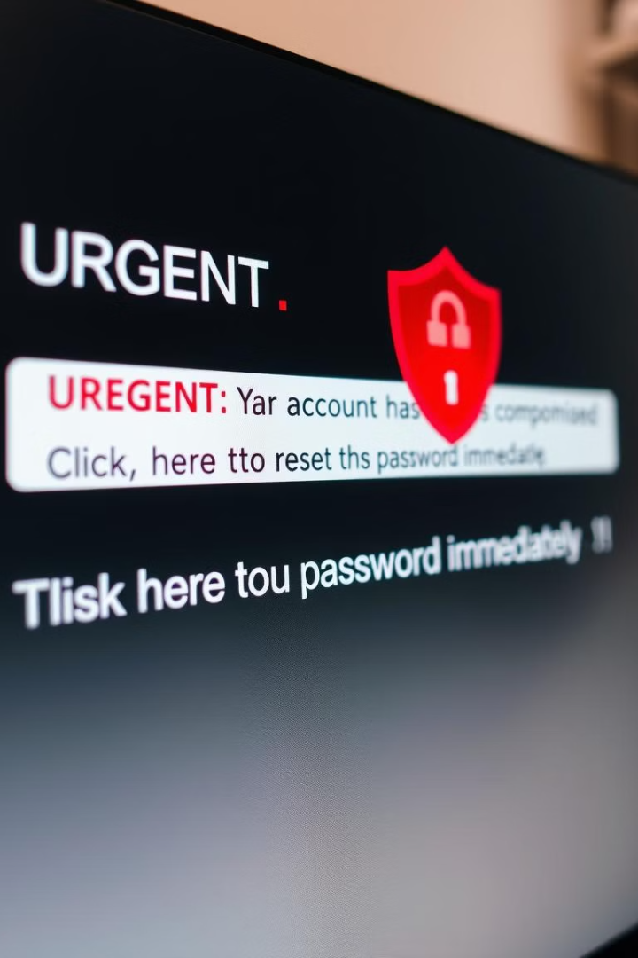




Introduction
Theoretical Background
Internet reliance
Cybercrime Risks
Phishing Definition
Users increasingly dependent on online services
The growing online presence has led to a rise in cybercrimes, with phishing attacks being one of the most damaging types.
Phishing is a type of social engineering attack where malicious actors create deceptive websites

Slide 4
Problem Statement
Traditional defense mechanisms such as URL blacklists or basic browser security alerts are often insufficient
because:
Phishing sites can appear extremely similar to legitimate websites, often using slight variations in URLs.
These sites are often short-lived, making blacklist updates slow and ineffective.
Users may not always be knowledgeable enough to identify phishing attempts.

Slide 5
Proposed Solution
Real-time Detection
Develop browser extension to identify fraudulent websites.
URL Analysis
Examine URL patterns for signs of phishing..
Machine Learning
Use algorithms to classify websites as phishing or legitimate.
Blacklist Integration
Maintain updated list of known legitimate sites.

Slide 6
Aims and Objective
Aims
Objectives
Real-time detection.
URL Pattern Analysis.
Enhanced protection.
Machine Learning Detection.
Reliable detection.
Known Phishing site Detection.
Cyber security awareness.

Slide 7

Review of Prior Feedback
Accuracy in Detection
Testing and making accurate detections.
Project Uniqueness
Highlighting the unique aspects of the project.
SSL Certificates
Addressing legitimate websites without SSL certificates.
Instance of Use
Demonstrating practical application scenarios.

Slide 8





Functional Requirements
URL Analysis
Analyzing URLs for suspicious patterns.
Machine Learning
Classifying URLs using machine learning models.
Real-time Alerts
Alerting users in real-time.
User Reporting
Enabling users to report suspicious sites.

Slide 9



Non-Functional Requirements
Performance
Ensuring rapid detection and minimal latency.
Scalability
Handling increased data and user load.
Reliability
Maintaining consistent and dependable operation.

Slide 10
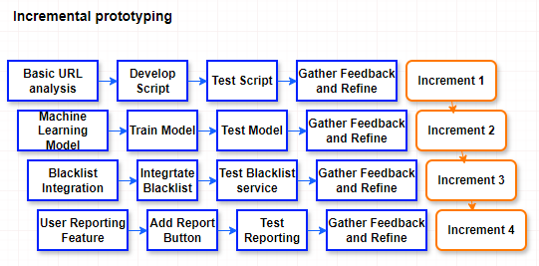
Incremental Prototyping
The project uses an incremental prototyping model. Each increment adds functionality to the system. This allows for continuous testing and feedback.

Slide 11
Tools and Technologies
Programming Languages
Development Tools
Python: URL analysis, machine learning.
Jupyter Notebook: Prototyping ML models.
JavaScript: Browser extension development.
Flask API: Integrating ML model.
Machine Learning
Database
Scikit-learn: Training phishing detection model.
MySQL: Storing URLs, user reports, training data.
Pandas & Numpy: Data preprocessing.

Slide 12
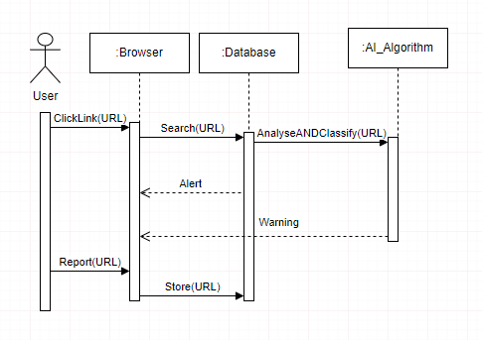
Conceptual Design

Slide 13
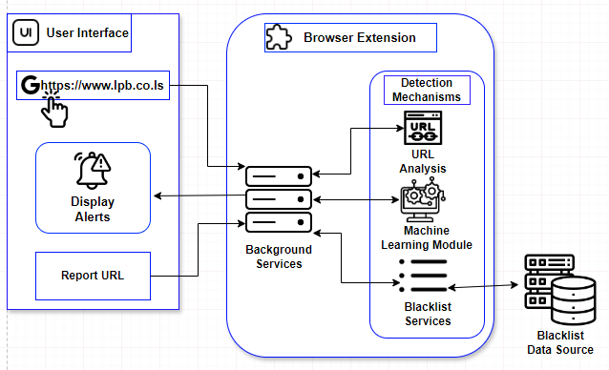
System Design

Slide 14
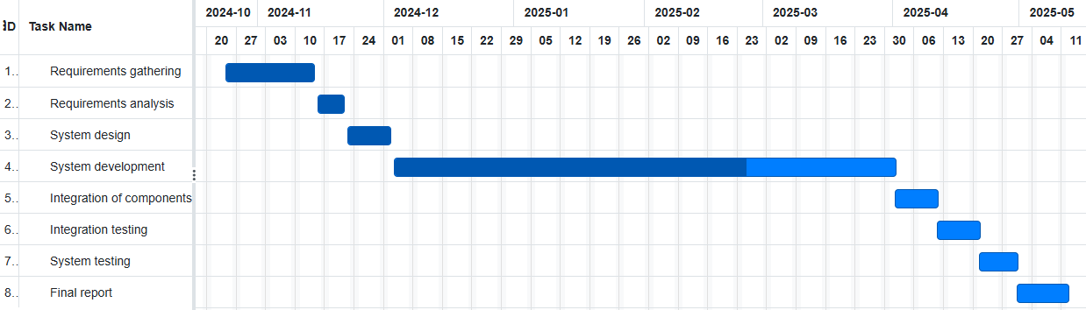
Project Timeline

Slide 15
Demonstration

